Slide 1


Economics as a Leaving Certificate Subject

Slide 2

Why study Economics?
Leaving Certificate Economics provides students with a learning foundation for a wide range of careers in business, economics, finance, enterprise and management.
There is a 20% research project that is completed in December of 6th year .. One fifth of your LC is done before you sit the exam!

Slide 3
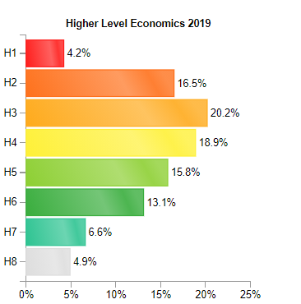
Leaving Certificate Economics – 2019 Statistics
To the left you can see the National Stats for LC Economics.
In Belvedere for the same year:
H1 – 12%
H2 – 29%
H3 – 32%
H4 – 9%

Slide 4
Exam Structure
The subject is examined at higher and ordinary level.
Research Project = 20%
Final Exam = 80%
2 hours and 30 min exam
Section A – Answer 8 short questions
Section B – Answer 4 out of 5 Extended Response Questions

Slide 5
Economics as a subject
Nice mix of theory, number, graphs and formulae
A hard working student has a great opportunity to achieve in this subject.
Every industry requires people that understand economics – construction, government, banking, sales, transport and management
20% of the LC Course will be completed before you sit the exam! A research project is completed in December of 6th year.
The results are generally high compared to other subjects.

Slide 6
Summary
Economics is regarded as the most practical business subject and is the study of how people manage limited resources such as money to meet their goals.
Economics deals with the real world business obstacles such as demand and supply, production and consumption, money and banking as well as economic policies, problems and conflicts.
It really suits students that have a general interest in how the economy works and be interested in current affairs. It would be important to be listening to the news and reading the daily papers.

Slide 7
Who is suitable for Economics?
It is not essential to have completed JC Business, but it is an advantage. Being a hard worker is key.
Students who have a keen interest in current affairs.
Concepts must be learned off by heart and applied to real life situations – some students can find this challenging.

Slide 8


Economics and numbers
In LC Economics there are formulae that have to be learned and applied.
Being confident with numbers is definitely an advantage when studying economics.
There is graph drawing and application of theory using diagrams.
There is quite a lot of theory – but no essay writing.
All theory is very factual that just has to be learned.

Slide 9
Course Content
Economics is split into Microeconomics (consumers, prices, demand and supply) and Macroeconomics (government as a whole and their objectives like employment, inflation and economic growth)
Main topics:
Demand, supply, equilibrium, utility and elasticity
Costs and market structures
Factors of production (including economists)
National income and the multiplier
Inflation, money, banking and monetary policy
International trade, balance of payments and the euro
Fiscal policy and taxation
The Government in the economy (including economic development and growth, population and emigration)

Slide 10
Careers
The Leaving Cert economics programme can be an advantage for students considering third level courses with an economics element to course content.
It is also useful for careers in Banking, Insurance, Finance, Marketing, Politics, Journalism, current affairs and all aspects of business.

Slide 11

Economics Teachers at LC Norma Shanahan and Sinéad McGouran

